Slide 1


Frontend
Testing
Gonzalo Martínez
gonzalo.martinez@uc.cl

Slide 2
Frontend
Reactivo
Espera input del usuario y reacciona
Cada acción tiene su reacción inmediata
Backend
Flujo Lineal

Slide 3
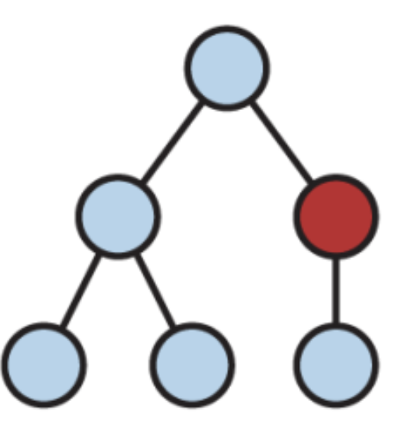
Frontend
Reactivo
Espera input del usuario y reacciona
Cada acción tiene su reacción inmediata
Cada input del usuario cambia el DOM
DOM: Document Object Model
Estructura Árbol

Slide 4
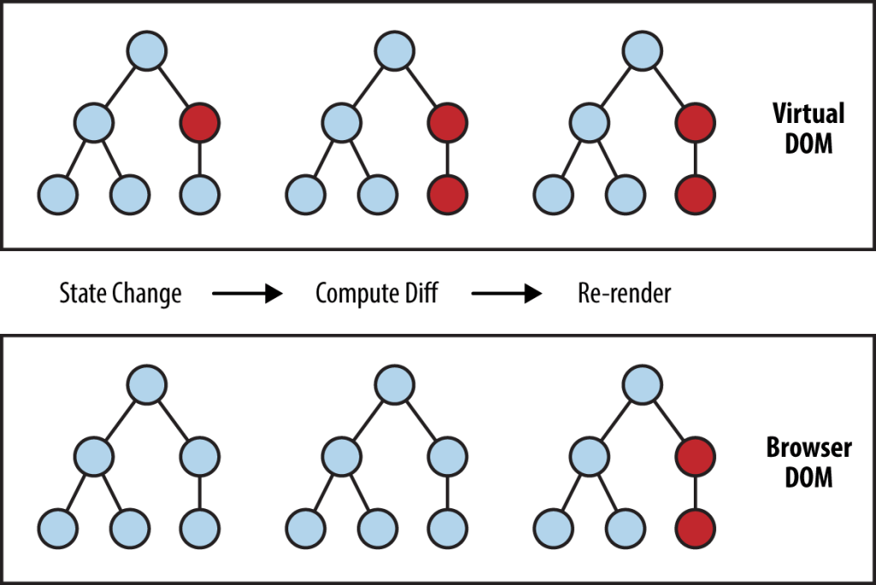

Slide 5
React
Cuando se produce un cambio en el estado de una componente de React (por ejemplo, debido a la entrada del usuario o la llegada de nuevos datos), React actualiza el Virtual DOM.
Luego, React compara la versión actualizada del Virtual DOM con una versión anterior (un proceso conocido como "diffing") para determinar exactamente qué cambios se necesitan hacer en el DOM real del navegador.
Finalmente, React aplica solo esos cambios específicos al DOM real, lo que minimiza las manipulaciones del DOM y mejora el rendimiento de la aplicación.
En el contexto de React y su Virtual DOM, cuando se realiza la comparación entre dos árboles de elementos (el proceso conocido como "reconciliation" o reconciliación), se podría conceptualizar qué React utiliza un algoritmo que tiene similitudes con DFS (Búsqueda por profundidad).

Slide 6
React
La elección de DFS sobre BFS en este contexto es principalmente debido a la naturaleza de las actualizaciones de UI: normalmente, los cambios tienden a estar agrupados y son más profundos que anchos.
No ocupa un algoritmo per se, si no un motor de reconciliación: Fiber Reconciler
Durante la reconciliación, React necesita identificar qué partes del DOM han cambiado para actualizar solamente esas partes.
React realiza este proceso de forma recursiva y desciende por el árbol de componentes. Este proceso se parece más a DFS porque React trata de ir lo más profundo posible en la jerarquía de componentes antes de moverse a través de los hermanos de esos componentes.

Slide 7
No hay un estándar para la organización de un proyecto React (frontend)

Slide 8
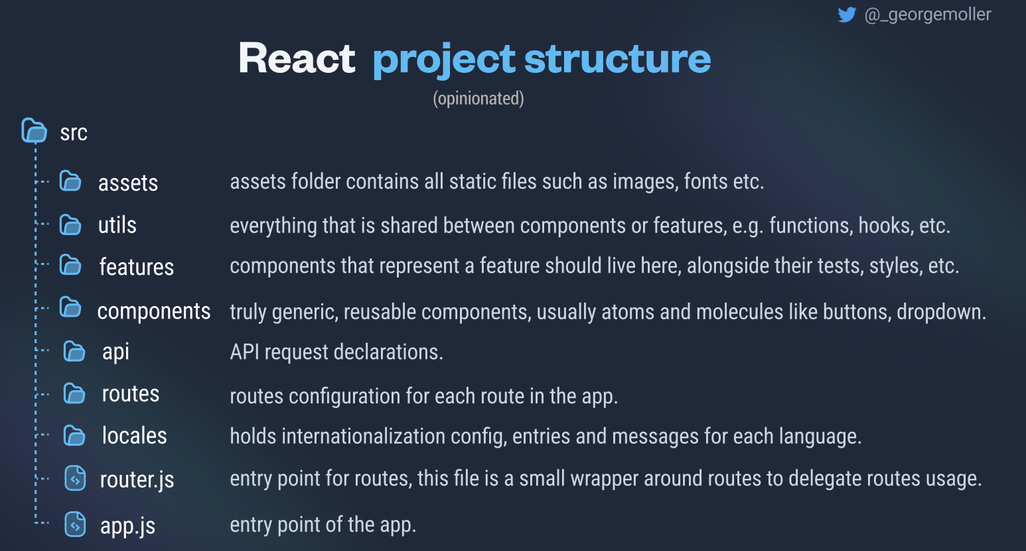
Organización del proyecto

Slide 9
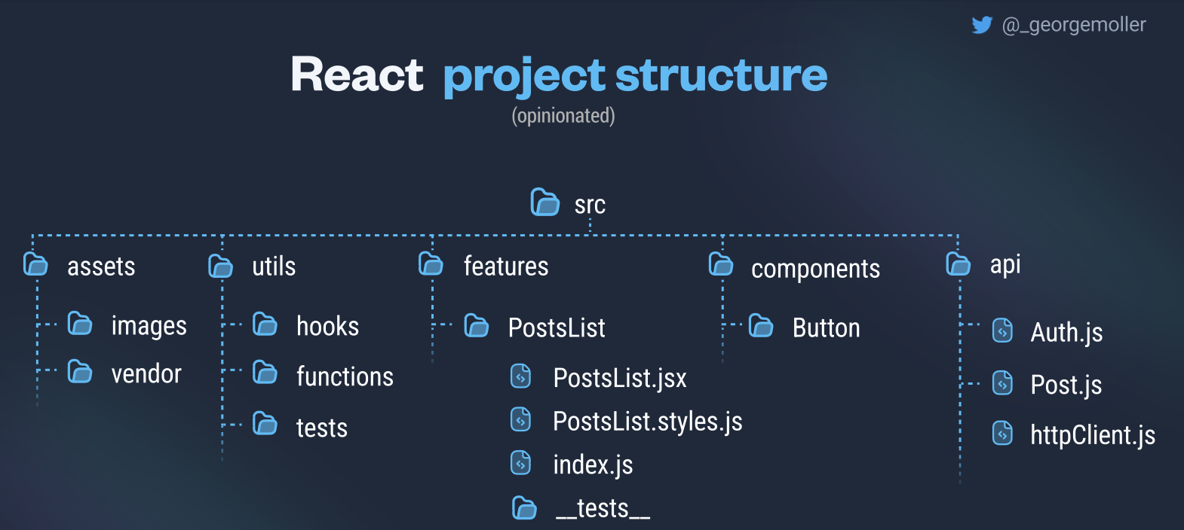
Organización del proyecto

Slide 10
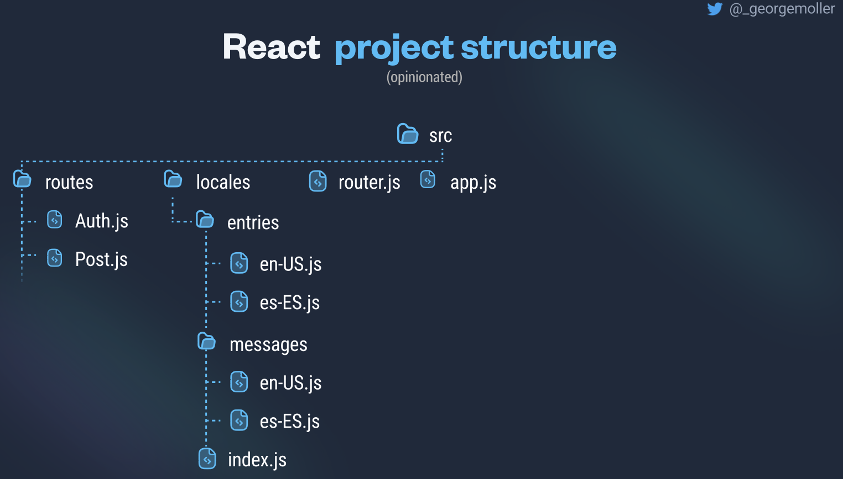
Organización del proyecto

Slide 11
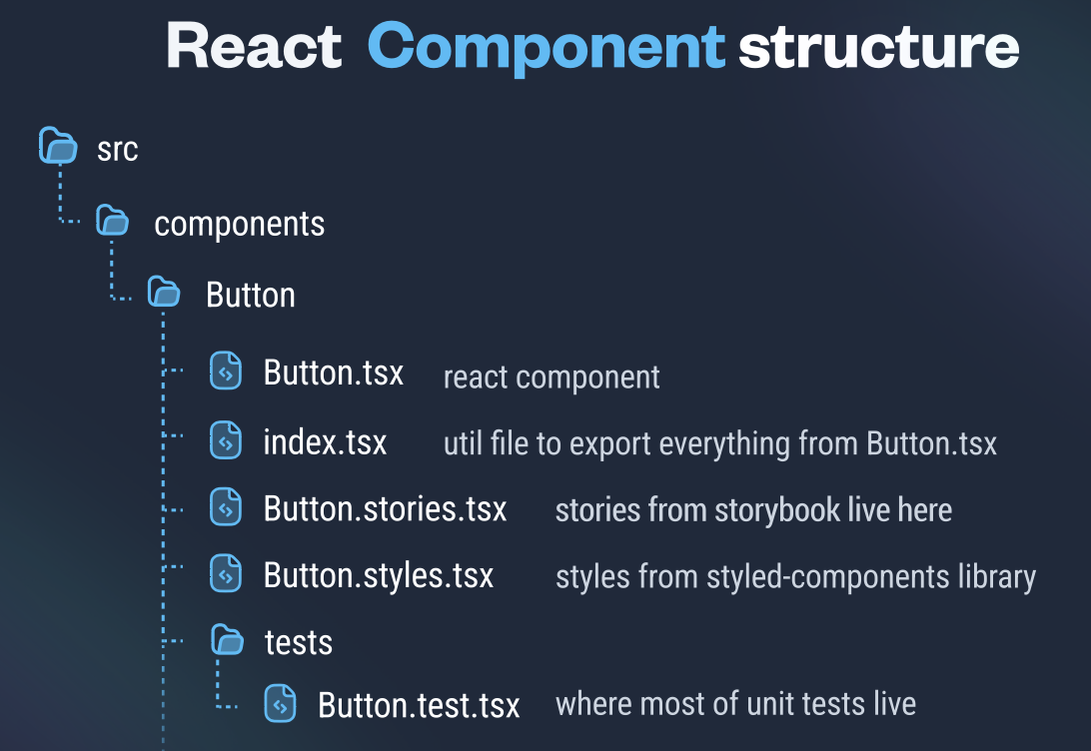
Organización del proyecto

Slide 12
Functional Programming Design
View
Render HTML/React components
useCase
Orchestrates user journey
Repository
Interacts with the application state
Adapter
Interacts with the network
Service
Handles business logic
Component
Custom Hook
Custom Hook
Pure Function
Pure Functions

Slide 13
useEffect
State Changes
React re-renders component
Dom is updated
Browser repaints the screen
useEffect runs

Slide 14
useEffect
useEffect(() => {
/*...*/
})
useEffect(() => {
/*...*/
}, [state, props])
useEffect(() => {
/*...*/
}, [])
Syncs with all data, runs after every render
Syncs with state & props, runs after any of these changes
Syncs with no data, runs only once after first render

Slide 15
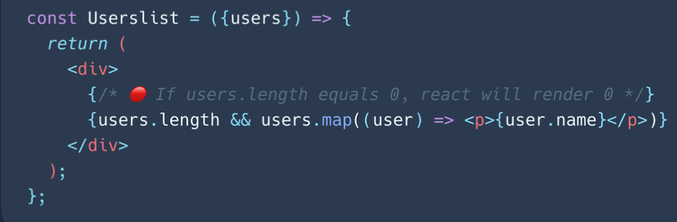
Common React Mistakes
When using conditional rendering, and using &&, don’t put numbers on the left side of &&.
If the left side is 0, then the whole expression gets that value (0).
Instead do:
users.length > 0

Slide 16
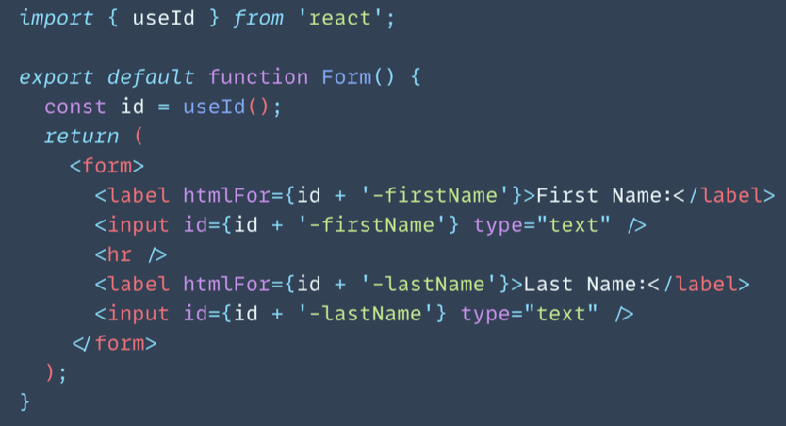
useId
useId is a React Hook for generating unique IDs that can be passed to accessibility attributes.
useId should not be used to generate keys in a list. Keys should be generated from your data.
Each item in a list needs a
different key

Slide 17
Frontend
Dado que el frontend es reactivo debemos verificar todas las interacciones del usuario con las vistas

Slide 18


React Testing Tools
Unit testing
Snapshot testing
Integration testing
Mocks, Stubs and Spies
Used by FB
Component testing
Avoid including implementation details in tests
Simulate user behaviour
Used by FB

Slide 19
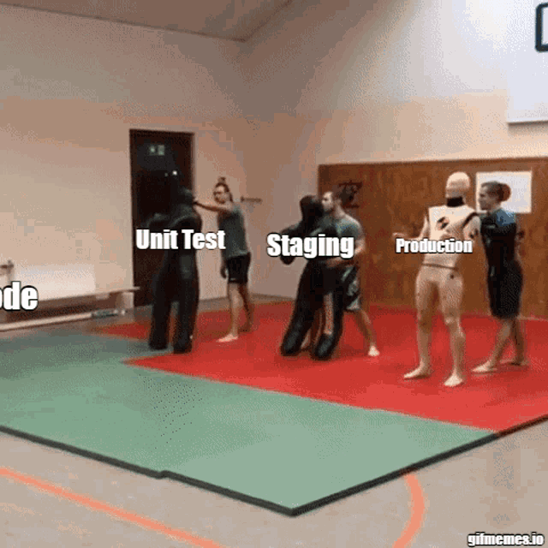

Slide 20
Testing on Frontend
You want your tests to avoid including implementation details of your components and rather focus on making your tests give you the confidence for which they are intended.
  Referencia:
    React Testing Library documentation

Slide 21
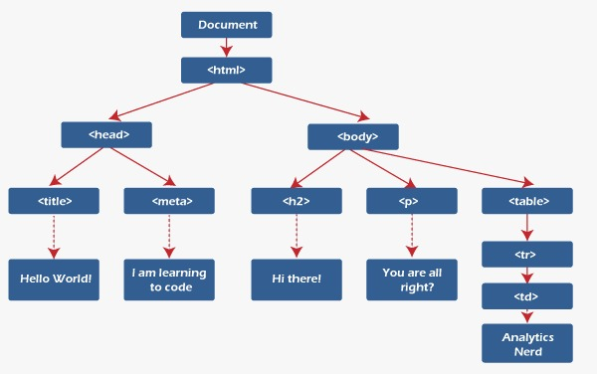
Frontend - DOM
Deberíamos verificar el estado de cada nodo por cada interacción
Recursión
Tree Traversal:
inorder - preorder - postorder
DFS
Notes:
Reference: https://www.javatpoint.com/what-is-dom-in-react

Slide 22
Unit Test
Unit Test
When unit testing class A, our focus is on testing A, as isolated as possible from the rest!
If A depends on other classes, we have to decide whether to simulate them or to make our unit test a bit bigger.
Class
B
DB
ATest
Class
A
Class
C

Slide 23
Frontend
Interact with
Function
User
Component
Function
Un componente contiene funciones
funciones cuyo output es tipo string

Slide 24
Frontend - DOM
Notes:
Reference: https://www.javatpoint.com/what-is-dom-in-react

Slide 25
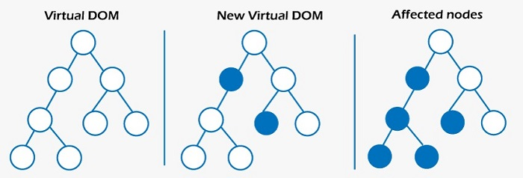
React DOM
Cada nodo contiene labels y textos.
Lo que hace React es cambiar el texto de cada uno de estos nodos.
Por lo que para verificar si todo es correcto debemos comprobar el texto de cada uno de estos nodos.
Notes:
Reference: https://www.javatpoint.com/what-is-dom-in-react

Slide 26
Frontend - DOM
Un React component viene a ser un conjunto de nodos a través del árbol
Notes:
Reference: https://www.javatpoint.com/what-is-dom-in-react

Slide 27
Client side testing
Interact with
Clicking
Typing
Scrolling
Open something
Function
Component
User
Page
Component
Una página puede interactuar con un componente

Slide 28
Client side testing
Interact with
Clicking
Typing
Scrolling
Open something
Function
Component
User
Page
Component
Un componente puede interactuar con un componente

Slide 29
Behaviour testing
(Test de comportamiento)

Slide 30
No probamos la interacción con backend. Eso se puede simular.

Slide 31
En frontend privilegiamos behaviour testing por vista o componente y E2E con Cypress

Slide 32
Diseño componentes
Contenedor (envoltorio)
hook: llamadas por la red (funcional)
Lógica de error
Business Logic

Slide 33
Diseño componentes
Business Logic
Render Conditional
Business Logic

Slide 34
E2E Cypress
cy.intercept("GET", "/restaurants", {
statusCode: 200,
body: [
{
id: "1",
name: "Repollo",
address: "myAddress 1",
contactEmail: "repollo@myResturant.com",
},
{
id: "2",
name: "El Pollo del 8",
address: "myAddress 2",
contactEmail: "pollodel8@myResturant.com",
},
],
}).as("getRestaurants");
Es posible interceptar llamadas REST

Slide 35
E2E Cypress
Interactuar con la página
it("Render the restaurant list fetched from the backend api", () => {
cy.visit("/");
// Wait for the intercepted API call to finish before proceeding
cy.wait("@getRestaurants");
cy.get('div[data-test="restaurant-list"]').should("exist");
cy.get("div.restaurant-item").should("have.length", 2);
});

Slide 36
E2E Patrón diseño: PageObject
class RestaurantPage {
clickOnFirstRestaurantDetails() {
this.getRestaurantItems().contains("View Details").eq(0).click();
}
currentUrl() {
return cy.url();
}
getRestaurantHeading() {
return cy.get('h2[data-test="heading"]');
}
getRestaurantItems() {
return cy.get("div.restaurant-item");
}
}

Slide 37
PageObject: considero cada página como un objeto con métodos
describe("Restaurant application", function () {
beforeEach(() => {
RestaurantPage.interceptRestaurants();
});
it("Render the Restaurant header", function () {
RestaurantPage.visit();
RestaurantPage.getRestaurantHeading().contains("Restaurants");
});
}

Slide 38
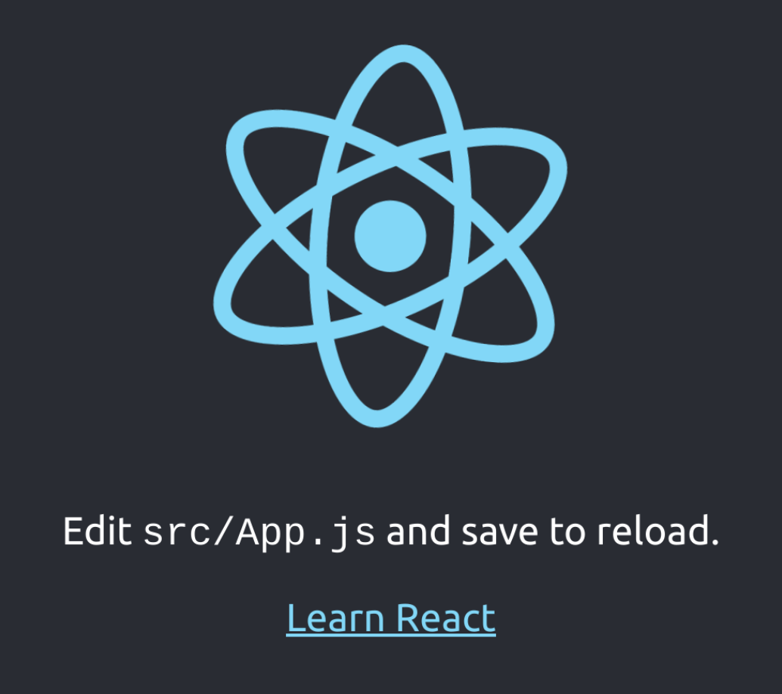
<body>
<div>
<div class="App">
<header class="App-header">
<img alt="logo" class="App-logo" src="logo.svg" />
<p>
Edit<code> src/App.js </code>and save to reload.
</p>
<a
class="App-link"
href="https://reactjs.org"
rel="noopener noreferrer"
target="_blank"
>
Learn React
</a>
</header>
</div>
</div>
</body>

Slide 39
Testing Library
screen
render
render
screen
fireEvent
Component1
Component2
Component3

Slide 40
Testing Library
screen
screen
render
render
fireEvent
render recibe un componente y sólo recrea su DOM almacenandolo en memoria
Component1
Component2
Component3

Slide 41
Testing Library - render
<body>
<div>
<div class="App">
<header class="App-header">
<img />
<p>
</p>
<a> Learn React </a>
</header>
</div>
</div>
</body>
test('renders learn react', () => {
render(<MyComponent />);
});
Crea y almacena en memoria el DOM del componente

Slide 42
Testing Library
screen
render
render
screen
fireEvent
screen recupera un elemento de la página
Component1
Component2
Component3

Slide 43
Testing Library - screen
<body>
<div>
<div class="App">
<header class="App-header">
<img />
<p>
</p>
<a> Learn React </a>
</header>
</div>
</div>
</body>
import { render, screen } from '@testing-library/react';
import App from './App';
test('renders learn react link', () => {
render(<App />);
const linkElement = screen.getByText(/learn react/i);
expect(linkElement).toBeInTheDocument();
});

Slide 44
Testing Library - screen
<body>
<div>
<div class="App">
<header class="App-header">
<img />
<p>
</p>
<a> Learn React </a>
</header>
</div>
</div>
</body>
import { render, screen } from '@testing-library/react';
import App from './App';
test('renders learn react link', () => {
render(<App />);
const linkElement = screen.getByText(/learn react/i);
expect(linkElement).toBeInTheDocument();
});
Obtiene todos los textos que contengan “learn react”, /i indica caseInsensitive

Slide 45
Testing Library - screen
test('renders a button', () => {
render(<MyComponent />);
const buttonElement = getByRole('button');
expect(buttonElement).toBeInTheDocument();
});

Slide 46
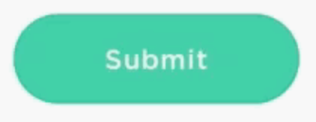
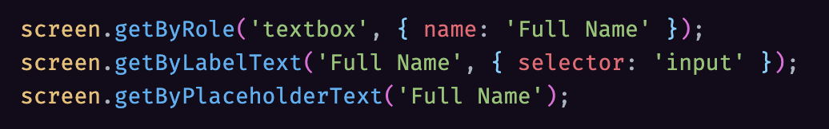
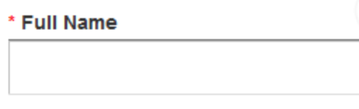
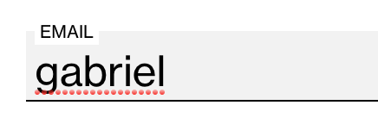





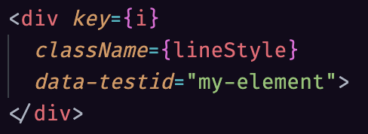



React Testing Library: Which query should I use?
https://testing-library.com/docs/guide-which-query
ByRole: top preference for accessible elements (button, checkbox, option, radio, etc.)
ByLabelText: will NOT find the input node for label text broken up by elements. You can use ByRole.
If you really can’t put a label in your UI, only then use ByPlaceholderText
ByDisplayValue: when you want to test when user fills data in an input
ByText: number 1 method for non-interactive elements like divs and spans
ByTestId: for cases where you can't use previous
matchers
querySelector: should be avoided most of the times, query by class or id is a bad practice

Slide 47
Testing Library - screen
<body>
<div>
<div class="App">
<header class="App-header">
<img />
<p>
</p>
<a> Learn React </a>
</header>
</div>
</div>
</body>
import { render, screen } from '@testing-library/react';
import App from './App';
test('renders learn react link', () => {
render(<App />);
const linkElement = screen.getByText(/learn react/i);
expect(linkElement).toBeInTheDocument();
});
jestMatcher verifica si se encuentra dentro del DOM

Slide 48
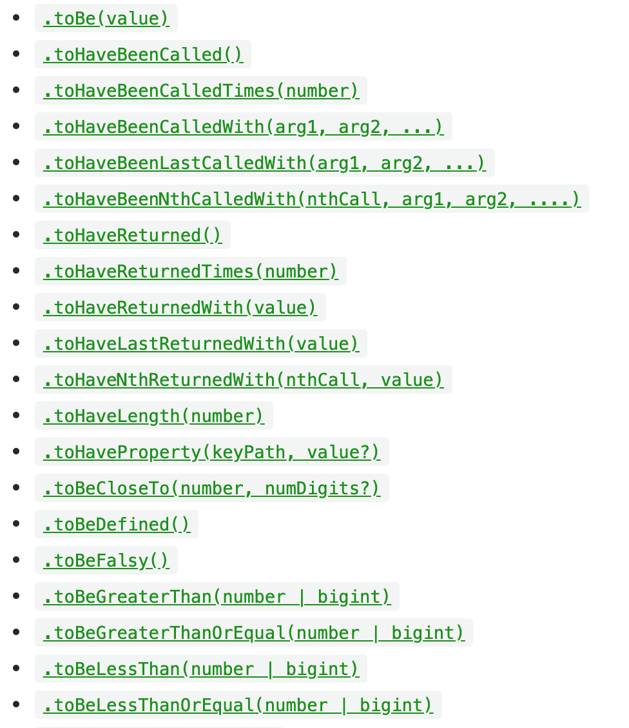
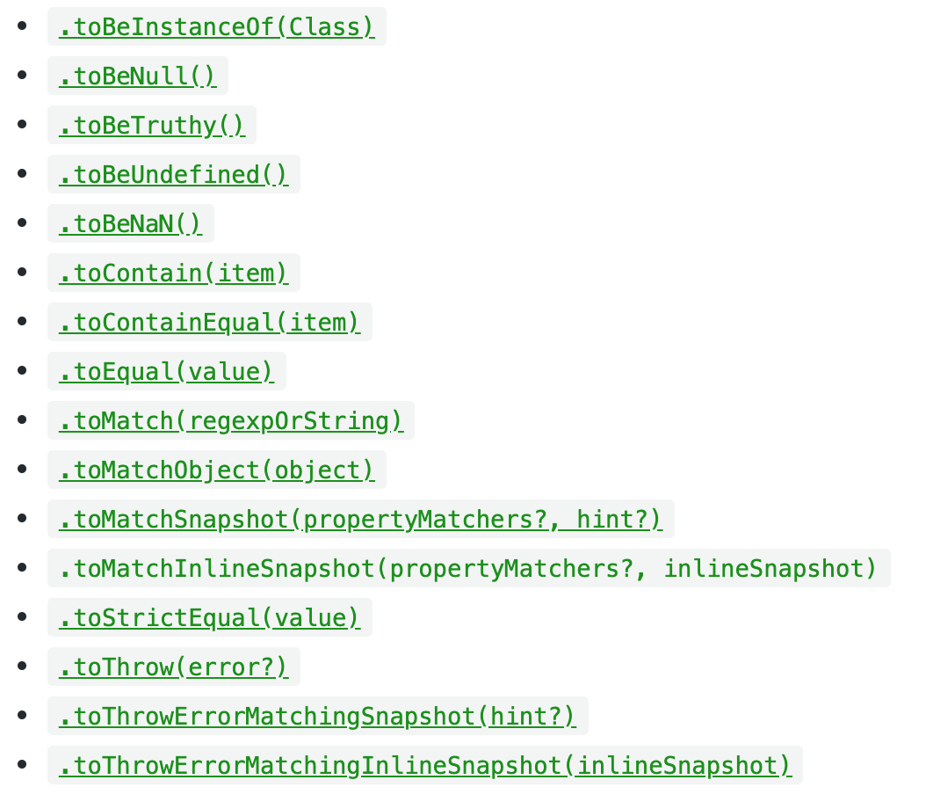
Jest matchers
https://jestjs.io/docs/en/expect

Slide 49
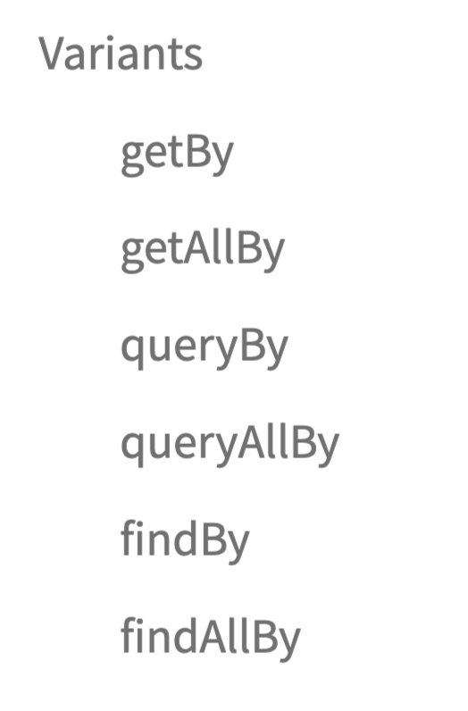
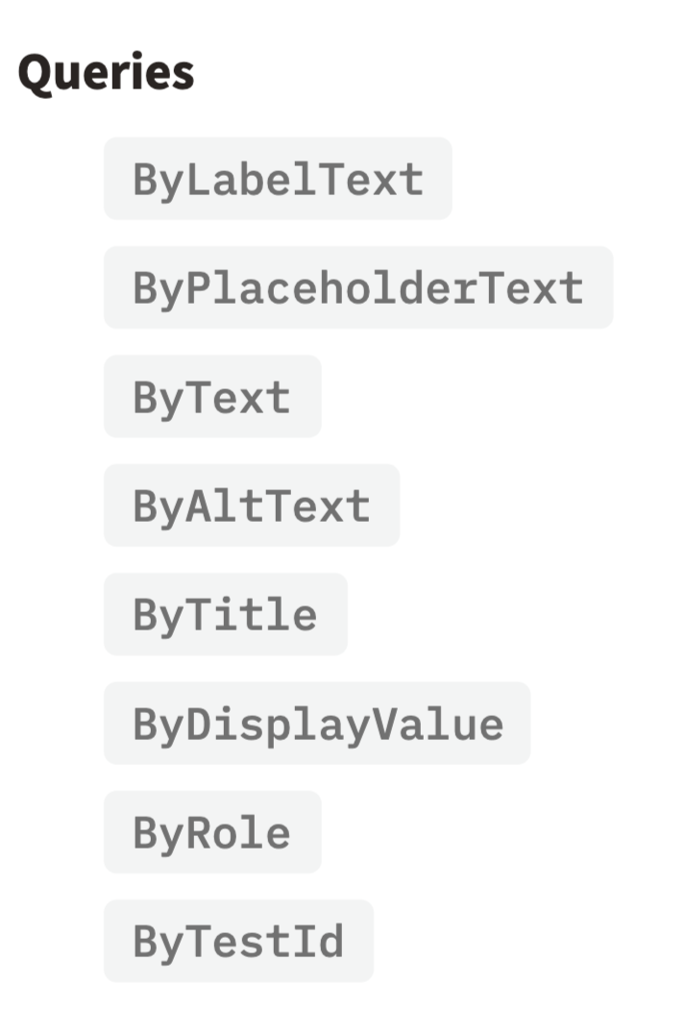
Component testing with React Testing Library
https://testing-library.com/docs/dom-testing-library/api-queries
Return type
Elem or error
Elem or null
Promise

Slide 50

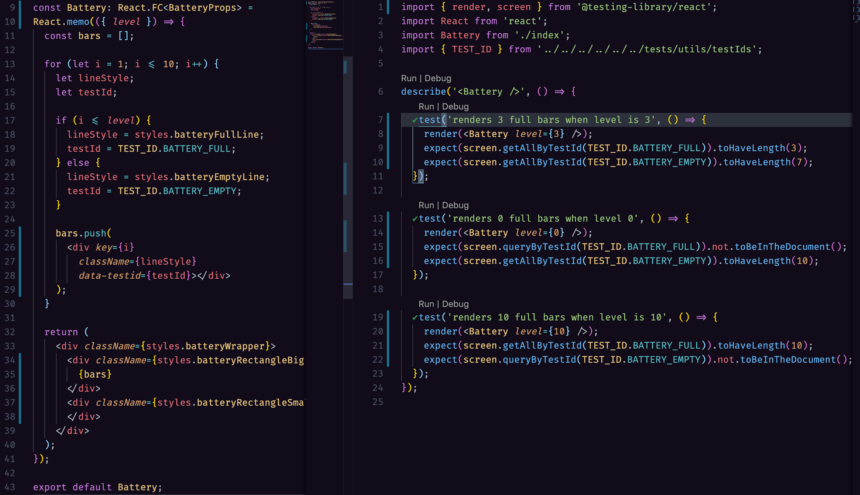
Component testing with React Testing Library

Slide 51
Testing Library
screen
render
render
screen
fireEvent
fireEvent simula interacciones del usuario
Component1
Component2
Component3

Slide 52
Testing Library - fireEvent
import { render, fireEvent } from '@testing-library/react';
import MyComponent from './MyComponent';
test('clicking the button triggers event', () => {
const { getByRole } = render(<MyComponent />);
const buttonElement = getByRole('button');
fireEvent.click(buttonElement);
// assertions here that check the result of the button being clicked
});

Slide 53
Testing Library - fireEvent
import { render, fireEvent } from '@testing-library/react';
import MyComponent from './MyComponent';
test('clicking the button triggers event', () => {
const { getByRole } = render(<MyComponent />);
const buttonElement = getByRole('button');
fireEvent.click(buttonElement);
// assertions here that check the result of the button being clicked
});

Slide 54
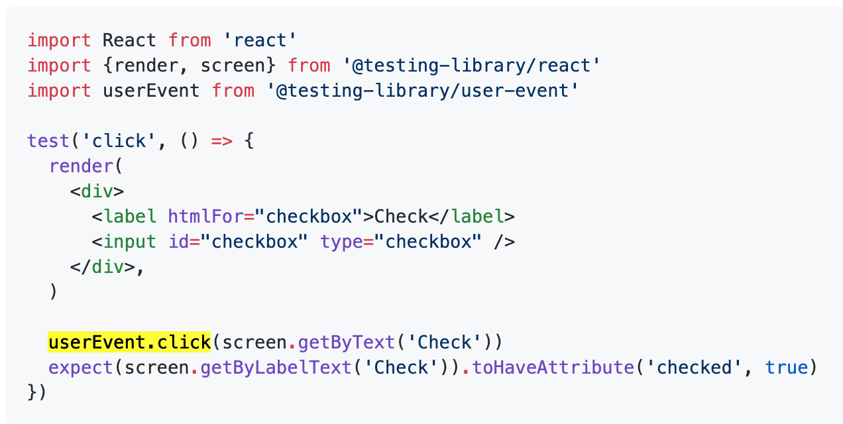
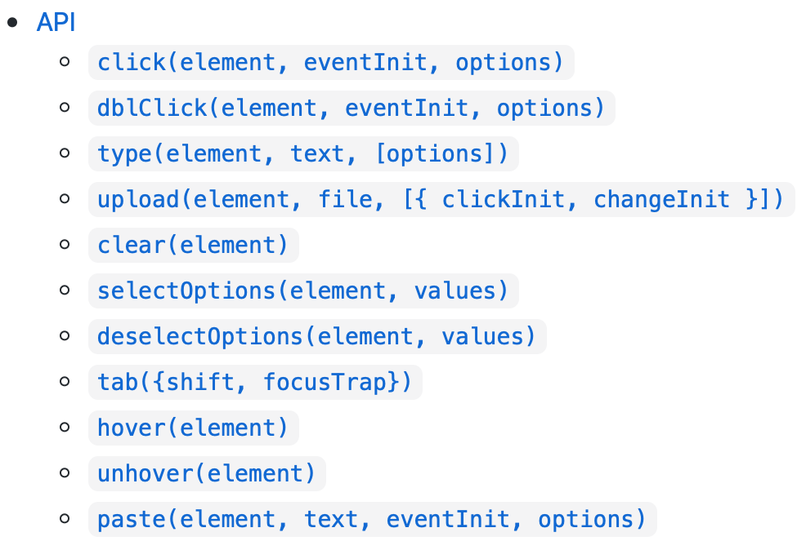
Testing user events with @testing-library/user-event
https://github.com/testing-library/user-event
user-event tries to simulate the real events that would happen in the browser as the user interacts with it
fireEvent antes se llamaba userEvent

Slide 55
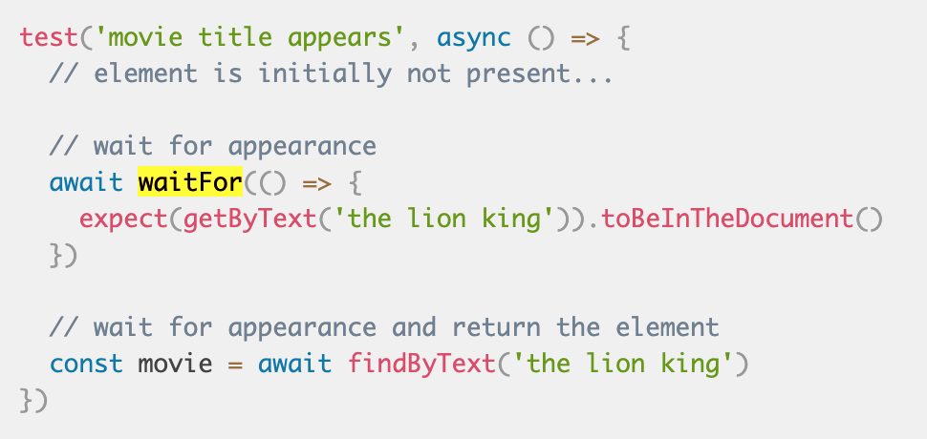
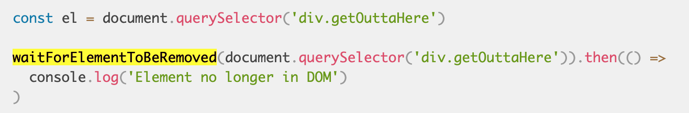
Handling async code
https://testing-library.com/docs/guide-disappearance

Slide 56
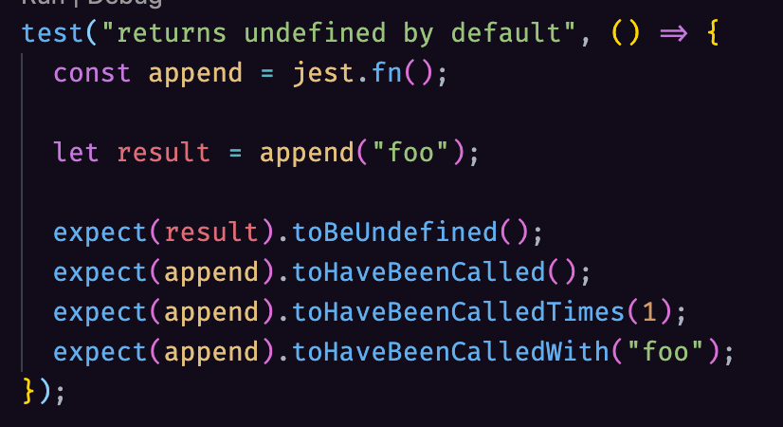
Jest Mock Functions
https://jestjs.io/docs/en/mock-functions
https://jestjs.io/docs/en/mock-function-api
A mock replaces the implementation of a function to help capturing calls to it and the parameters passed and set different return values.
Mocking is a technique to isolate test subjects by replacing dependencies with objects that you can control and inspect.
The goal for mocking is to replace something we don’t control with something we do
Mock functions are also known as "spies", because they let you spy on the behavior of a function that is called indirectly by some other code, rather than only testing the output.
You can create a mock function with jest.fn(). If no implementation is given, the mock function will return undefined.

Slide 57
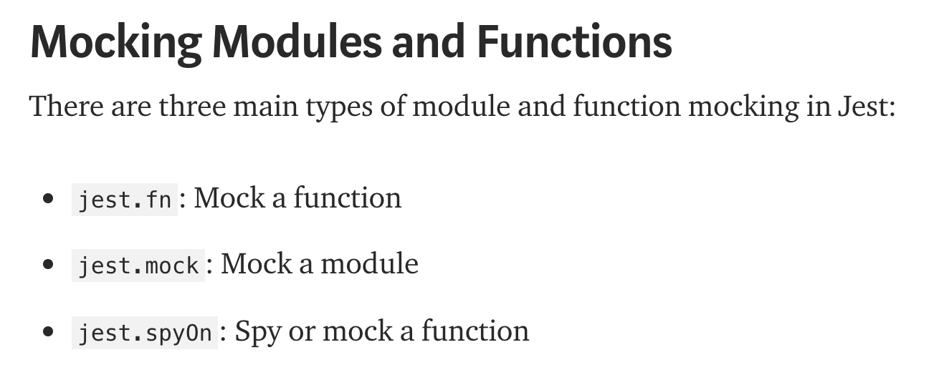
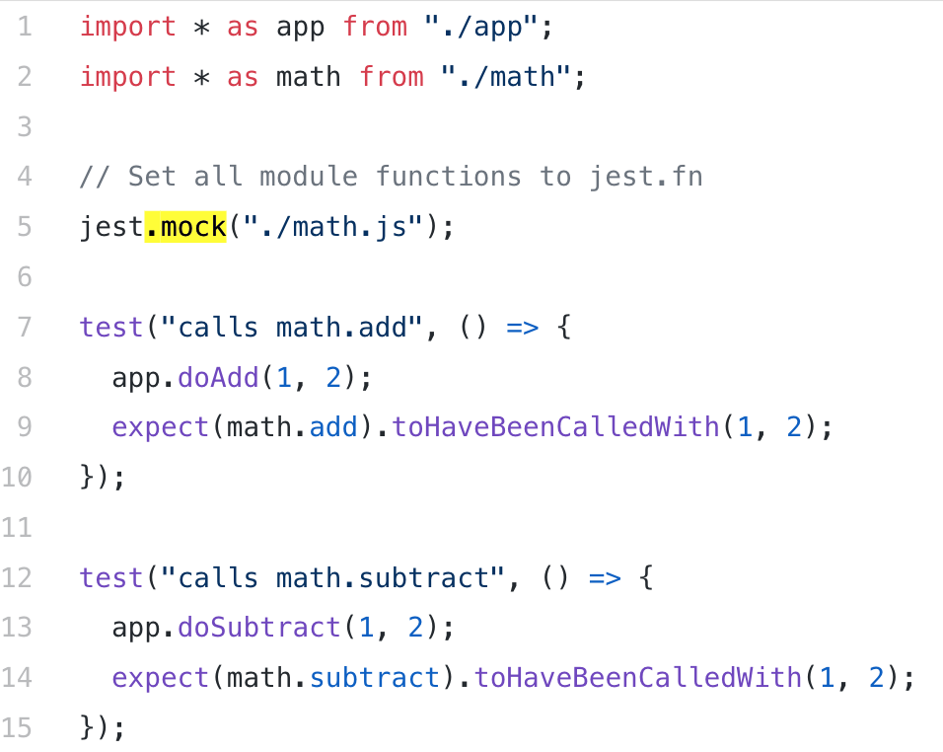
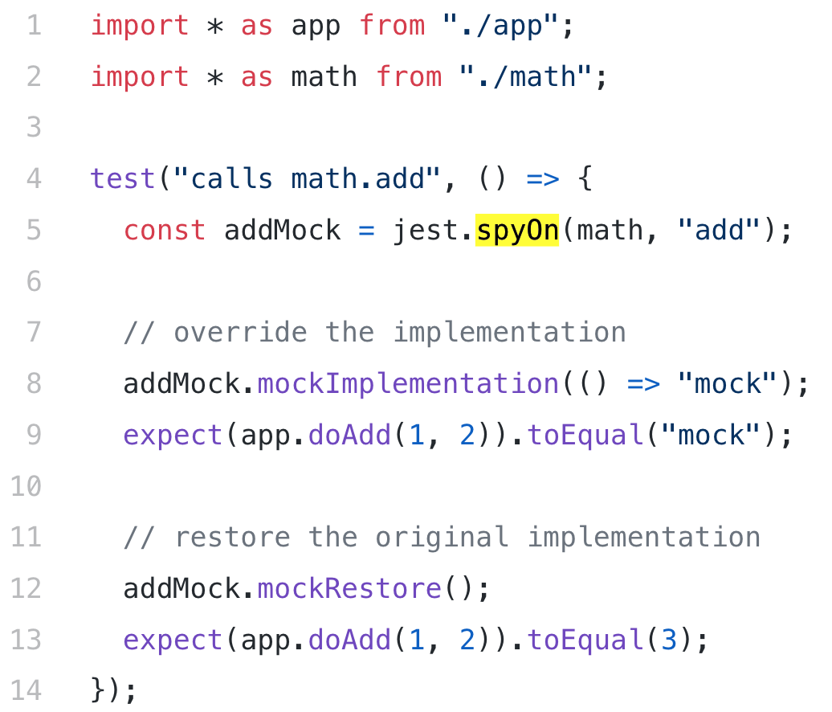
Jest Mocking Modules and Functions
https://medium.com/@rickhanlonii/understanding-jest-mocks-f0046c68e53c
does jest.fn() automatically for all functions in a module
same thing + allows restoring the original function

Slide 58
Snapshot testing

Slide 59
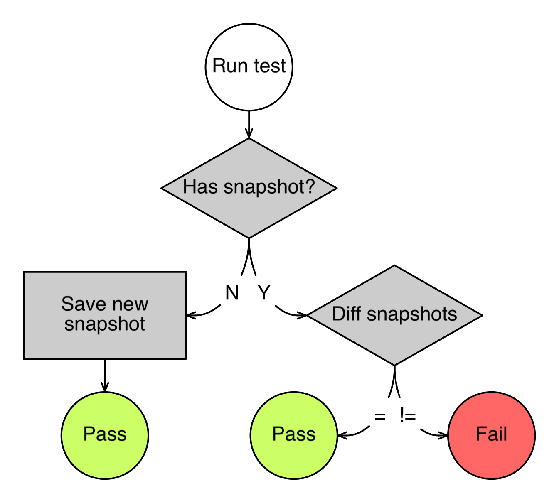
Snapshot testing

Slide 60
Snapshot testing
Jest allows “snapshots” of data with toMatchSnapshot(). This will “save” the rendered component output and ensure that a change to it has to be explicitly committed as a change to the snapshot.
Instead of rendering the graphical UI, which would require building the entire app, you can use a test renderer to quickly generate a serializable value for your React tree.
  Tradeoff: break easily

Slide 61
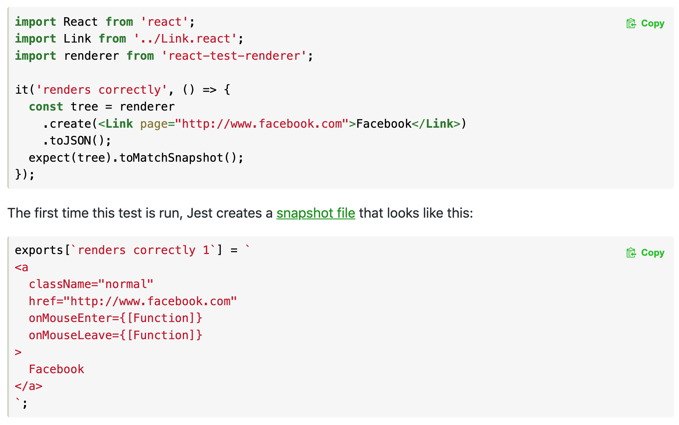
Snapshot testing

Slide 62
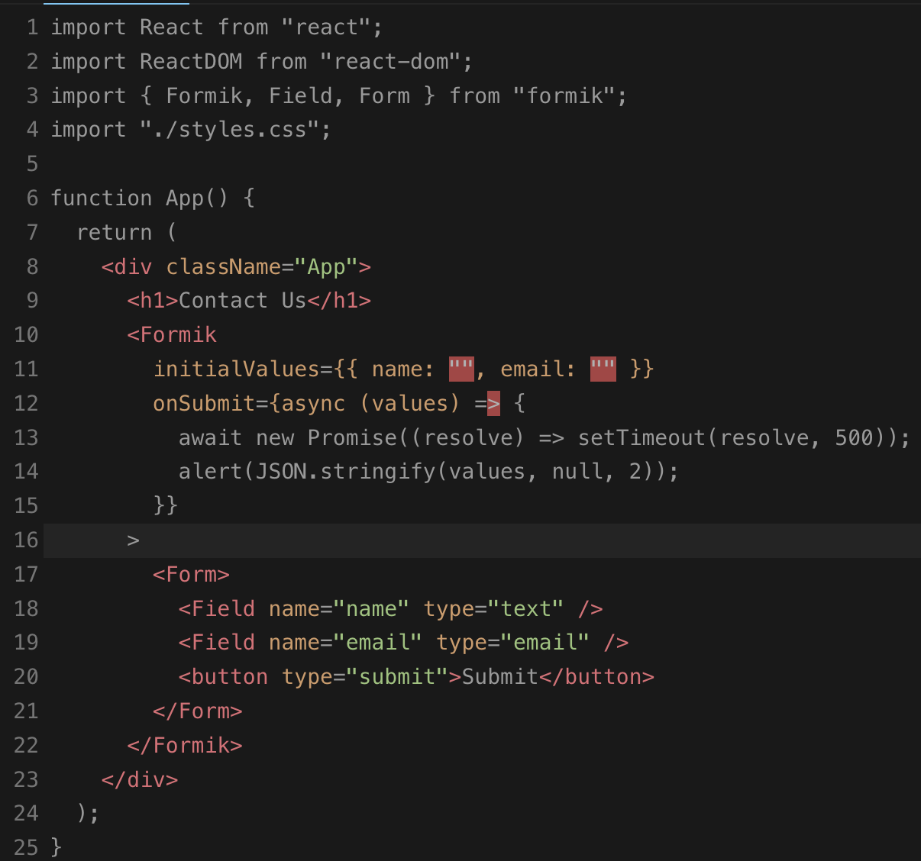
Form: Formik
Formik is a TypeScript library for creating and validate form fields.
Alternatives:
React-form
Yup
https://formik.org/

Slide 63
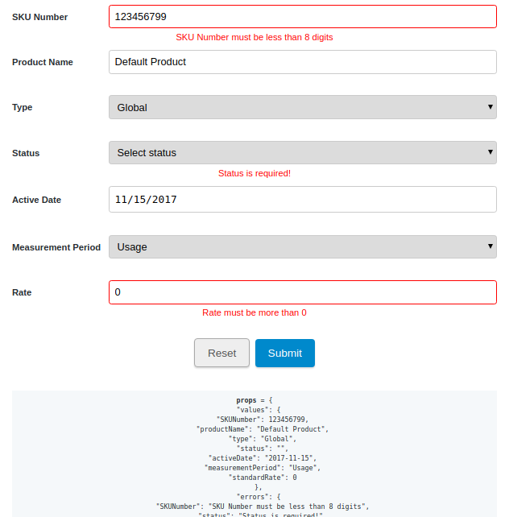
Form: Formik
Formik is a TypeScript library for creating and validate form fields.
Alternatives:
React-form
Yup
https://formik.org/

Slide 64
Validaciones: Zod
import { z } from "zod";
// Define a schema
const UserSchema = z.object({
name: z.string(),
email: z.string().email(),
age: z.number().min(0).max(150),
});
// Type for user derived from the schema
type User = z.infer<typeof UserSchema>;
// Now User type is equivalent to:
// type User = {
// name: string;
// email: string;
// age: number;
// };
Zod is a TypeScript library for creating schemas to validate your JavaScript or TypeScript data at runtime. Zod schemas can be used for validating and parsing data, such as data received from an API or a form input.

Slide 65
Validaciones: Zod
// Some example data
const exampleData = {
name: "Alice",
email: "alice@example.com",
age: 25,
};
// Validation
const validationResult = UserSchema.safeParse(exampleData);
if (!validationResult.success) {
console.error(validationResult.error);
} else {
const user: User = validationResult.data;
console.log(user);
// user is now guaranteed to conform to the User type
}
Zod is a TypeScript library for creating schemas to validate your JavaScript or TypeScript data at runtime. Zod schemas can be used for validating and parsing data, such as data received from an API or a form input.

Slide 66
Frontend
Development
Gonzalo Martínez
gonzalo.martinez@uc.cl

